Slide 1


Alpha Phi Omega
Chi Chapter at UCLA
Alpha Lambda / Yuna Choi Term, Meeting 3
April 2, 2014
www.apo-x.org

Slide 2
Agenda
1. Officer Updates and Announcements
2. Chapter Business
3. Last Announcements

Slide 3
President
Jessica Suhardjo
president@apo-x.org
Executive Committee
excomm@apo-x.org

Slide 4

Leadership Workshops
Launch write-ups due midnight tonight to apoxpresident@gmail.com
Host your own
workshop!

Slide 5

Leadership Opportunities
Volunteer with COPE!

Slide 6
Gamer’s Guide Tip #3
“I’ve learned that people will forget what you said, people will forget what you did, but people will never forget how you made them feel.”
- Mary Angelou

Slide 7
Administrative VPs
Joseph Chan & Nicola Yip
admin@apo-x.org

Slide 8

Updates
Pledges: if you don’t send in your picture for the website by Friday, we will use your roster picture
Look out for our newsletter :)

Slide 9
Membership VP
Jeremy Gozzip & Melissa Ma
membership@apo-x.org

Slide 10
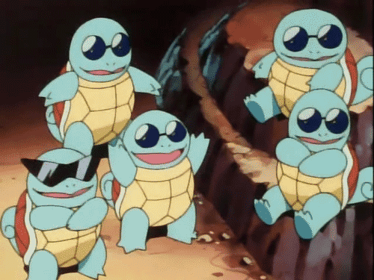
Committees
Assignments have been made!
Check on the Committee/Voting tab on the tracker if you do not know what committee you are on.
If you are a Good-Standing Active, you have a committee.

Slide 11

Campout
Please come! :]
Drivers please sign up to go!
Be there by 11AM.
Please only sign up for either Friday or Saturday on the calendar.
If you are going all three days, sign up on Friday.
If you are going just on Saturday, please sign up on Saturday.

Slide 12

Revelations
SUNDAY 4/13
Tell your lines to come out! :]
More details to come...
*It counts as a chapter event.

Slide 13
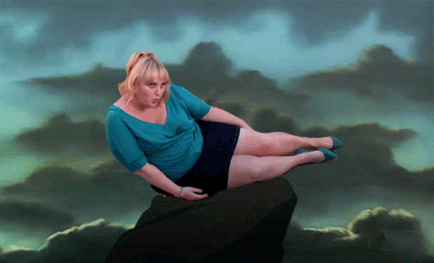
Mid-Chapter Evals
Please fill them out!
Now is NOT the time to be a Rebel (Wilson).
*Note: We have different sheets for Actives and Pledges.
Your feedback is highly valued. :3

Slide 14

Shoutout Book
Give your brothers a shoutout!
If you want to write in the book, please see MELISSA BARCELONA or MEGAN KAKITSUBO (Retention Committee) before or after meeting.
E-mail submissions will also be accepted. Please send to apoxmembership@gmail.com with the subject line reading: “Shoutout Book Entry”

Slide 15

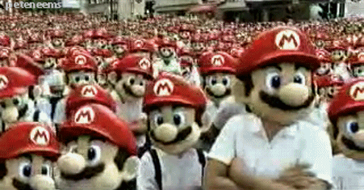
Achievement # 2
LEVEL 2: Take a picture of 5 people in your family with mustaches doing the Mario jumping pose.
EXTRA points for REAL mustaches.
3 class minimum.

Slide 16
Active Missions
Sign-ups open after meeting, end Sunday night.
Active Mission #1 is due CM 5.
Groups will be randomly assigned.
Link has been made and will be sent out tonight.
Each person who successfully completes the Active Mission earns Family points!
EXTRA points for the best ones.

Slide 17
Active Mission # 1
Groups will solve riddles/trivia given by MVPs to gain ingredients.
One correct answer= one secret ingredient
Use those ingredients to make a dish!
Need to send in picture proof of the cooking process to MVPs
Winner will decided by a blind taste test by the MVPs.

Slide 18
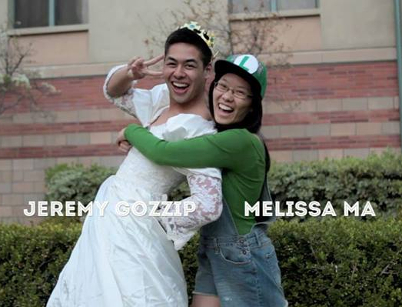

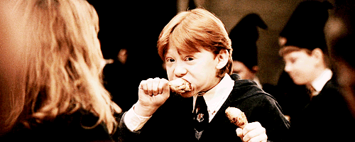
Dinner with Membership
WEDNESDAY, April 9
(it’s on the calendar)
Please let us know if you will be joining us at least one day in advance.

Slide 19

Spirit Committee Game
yayyyy

Slide 20
Service VPs
William Nguyen & Jade Vo
apoxservice@gmail.com

Slide 21

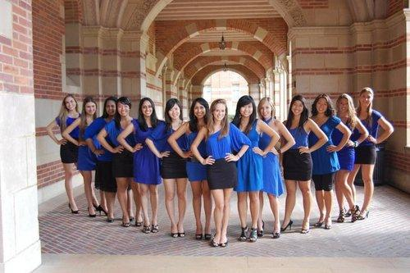

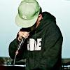
Benefit Concert Updates
Talent Wanted!
Artists!
Sound!

Slide 22

Relay For Life
In the process of setting it up. Sorry for the delay!

Slide 23
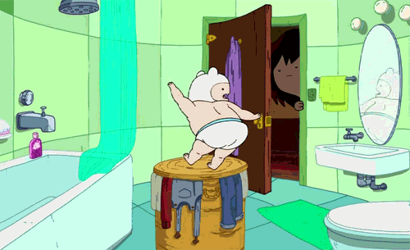
Dance Marathon!
This will count as 24 hours of service!
If you are not dancing BUT you are moraling then we will give you a maximum of 4 hours!
Come support our brothers!

Slide 24

SBotW!
And the Service Brothers of the Week are…

Slide 25
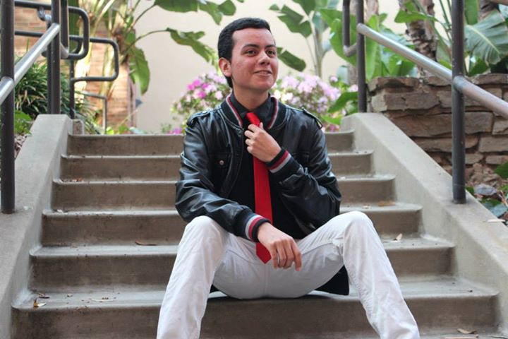
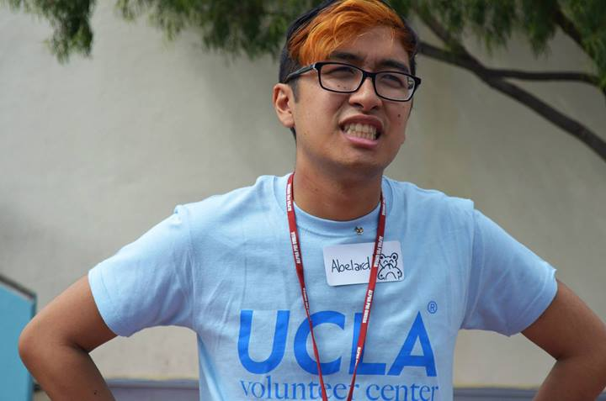
SBotW!
Ernesto Bustinza! Abelard Bautista!

Slide 26

SBotW Nominations
Nominate your favorite brother of the week for Service!
Provide the name of the brother and a small explanation why they should be honored!
lisalau94@gmail.com
323-360-8918

Slide 27
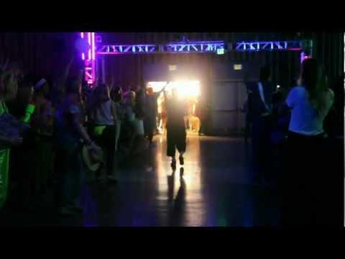

Education Committee Presents: Dance Marathon!

Slide 28


Eduction Committee Presents: Dance Marathon!
Everyone must KNOW about the cause NOW!
70% to Elizaberth Glaser Pediatric AIDS Foundation
20% to Project Kindle
10% to UCLA AIDS Institute
$475,422.57 was raised in 2013!

Slide 29


Education Committee Presents: Dance Marathon!

Slide 30
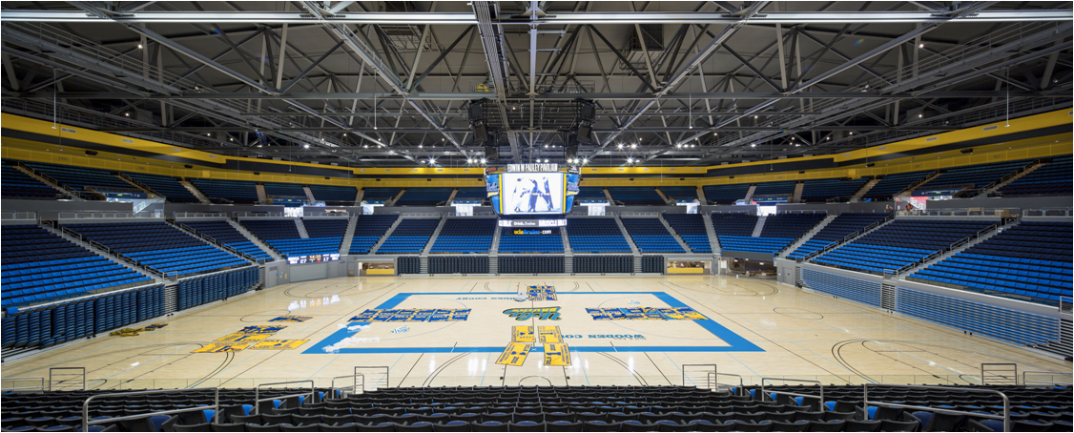
Education Committee Presents: Dance Marathon!
13th annual Dance Marathon at UCLA from 11 AM to 1 PM at Pauley Pavilion
EVERY DANCER needs to raise at least $250 PLEASE HELP YOUR BROTHERS OUT

Slide 31
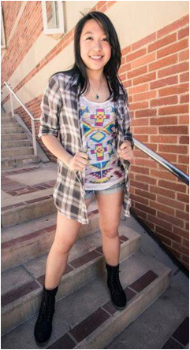
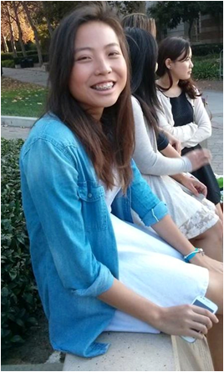
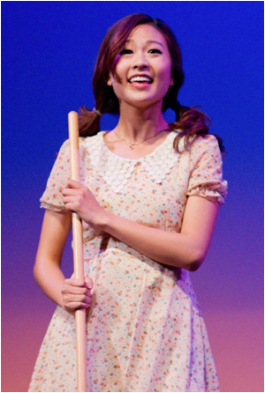
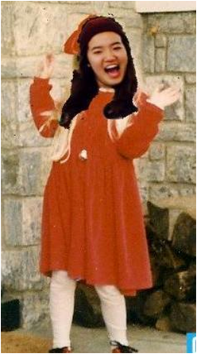
APO DANCERS!
STACEY MAGGIE HAZEL JEESUN

Slide 32
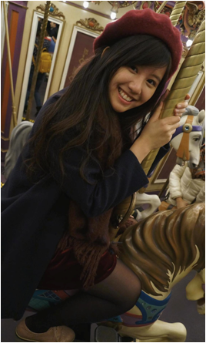
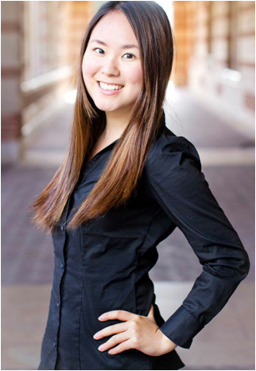
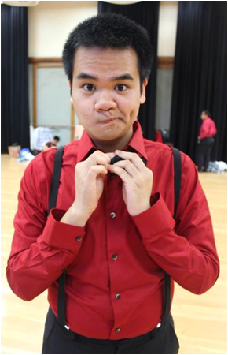
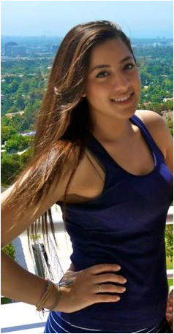
APO DANCERS!
STEPHANIE MEGAN PETER MARIA

Slide 33
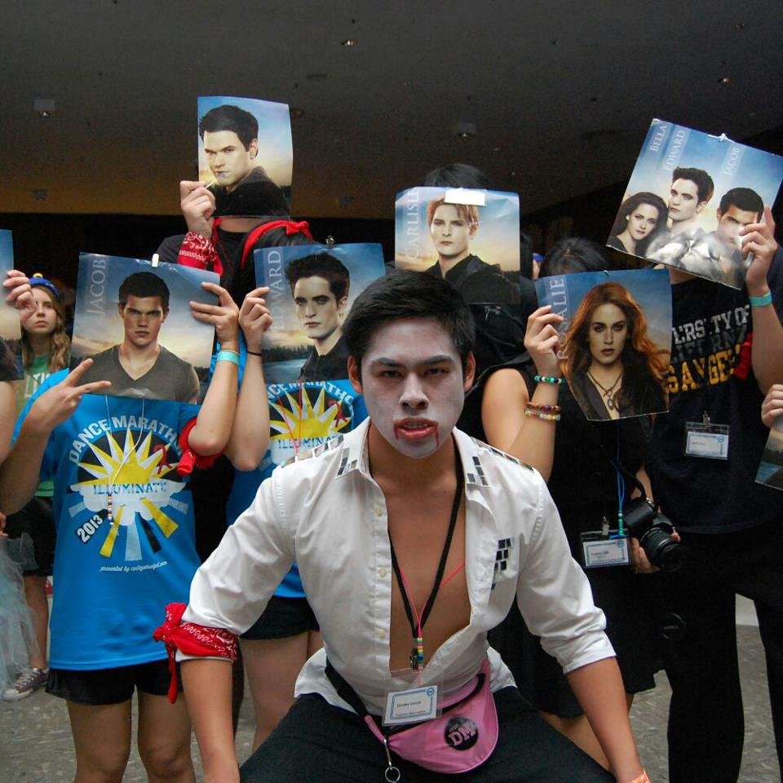
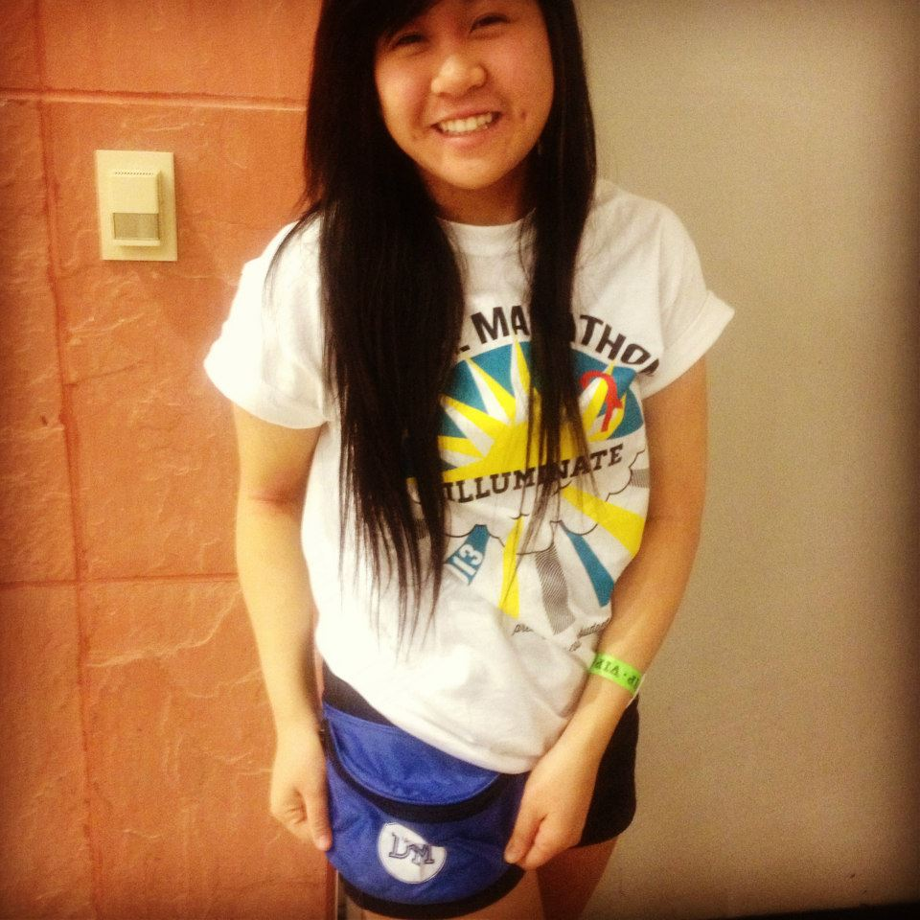
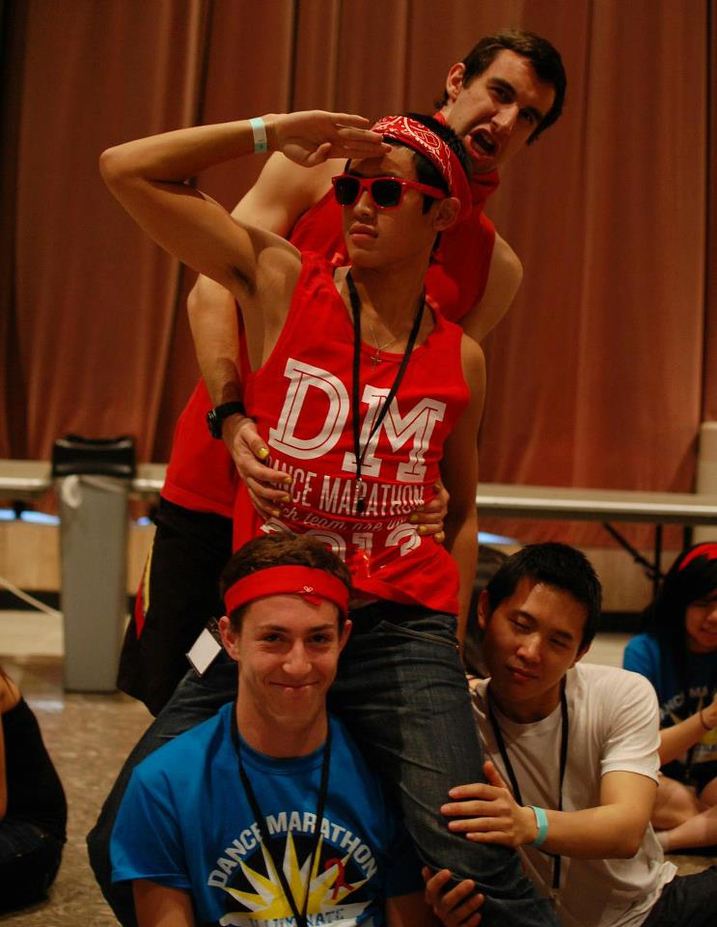
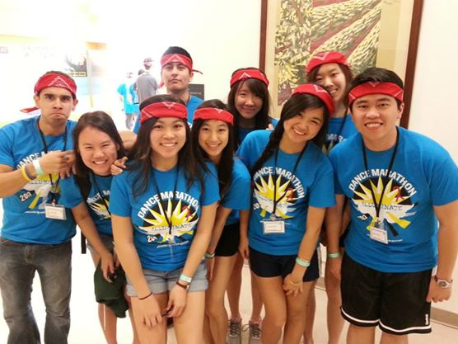
Dance Marathon!
Our Brothers at past Dance Marathons!

Slide 34
Pledge Parents
Sean Tran & Annie Tran
pledgeparents@apo-x.org

Slide 35
Pledges
Quiz 3
Greek Alphabet lower and upper
Music Videos!!
Campout and initiation
Interviews

Slide 36
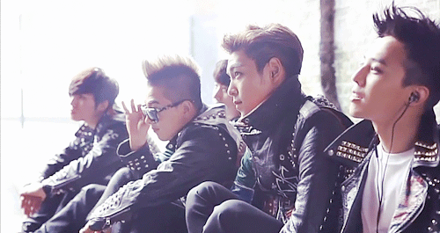
Actives
Campout!!! This weekend
Revelation has been moved
Interviews

Slide 37

Big Little EVERYTHANG
MOST of the big/lil tracking is done
Big little aps are coming out tonight
Actives due Monday at 12am so sunday night.
Pledges will be due tuesday
revisions
Campout revelations
Keep calm. LOL

Slide 38
Music Video kekeke
https://www.youtube.com/watch?v=n3BfE5qEp3s

Slide 39
Finance VPs
Emily Neai-Proeung & Jonathan Liu
finance@apo-x.org

Slide 40
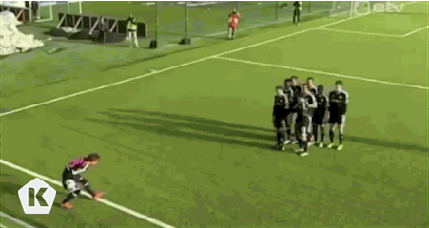
TV Tapings!
Winklers, Thursday April 3rd! (new ABC comedy!)
Your Family Or Mine, Thursday April 10th! (new TBS comedy & bussable!)

Slide 41



Fundraising update!
Amount of money raised so far: $260.92
Fundraising goal: $2800

Slide 42

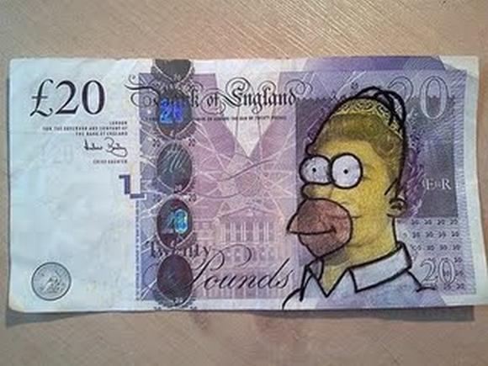
PAY YO DUES!
Actives & pledges on the payment plan: $20!
Remember to pay or you’ll go bad standing/be depledged!

Slide 43
Fellowship VPs
Michael Hung & Dianne Pham
fellowship@apo-x.org

Slide 44
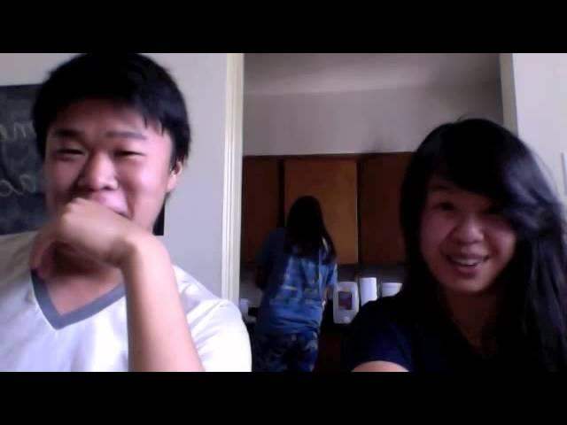
FELLOWSHIP FUN LOG

Slide 45

Sign up for fellowships!
And tell us ideas via
- binder
- Facebook
- email
- word of mouth

Slide 46
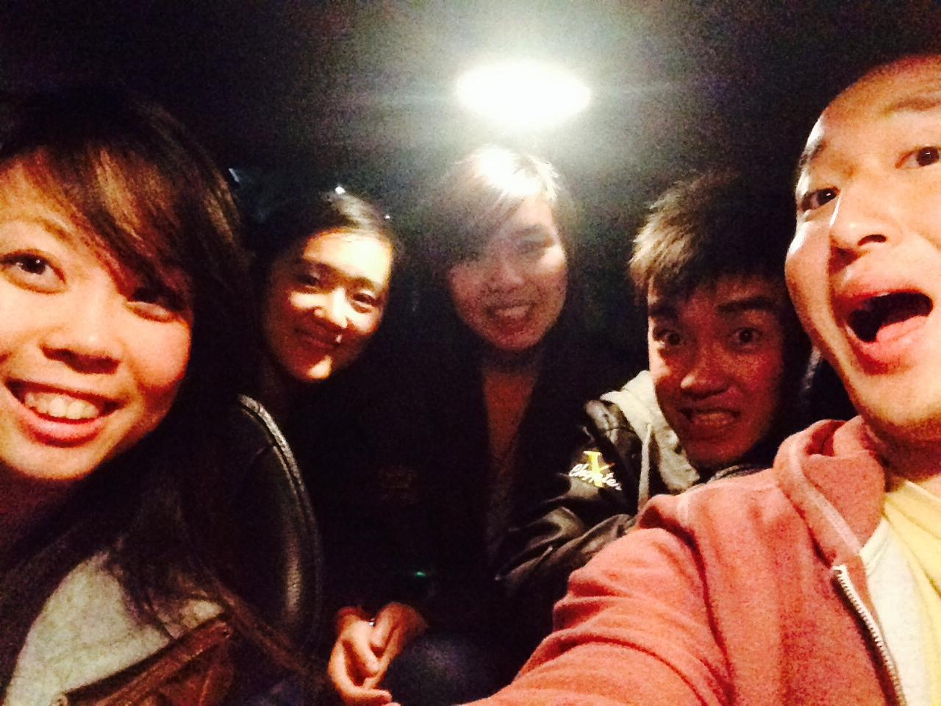
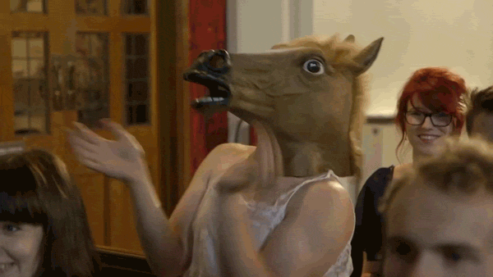
Fun Foursies
Hope they’re going well!
Due CM #4 (in two weeks)
LOOK HOW MUCH FUN THIS IS. SO FUN. MUCH FOURSIES.
...Fivesies?

Slide 47
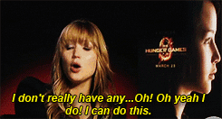
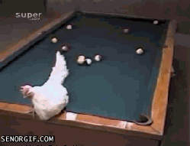
Talent Show!
Talent Show will be happening May 2nd at The SEED Center.
$30/person. Sign up!
Performers: Sign up on the binder or email us at apoxfellowship@gmail.com!
All acts appreciated!
ALL acts.

Slide 48
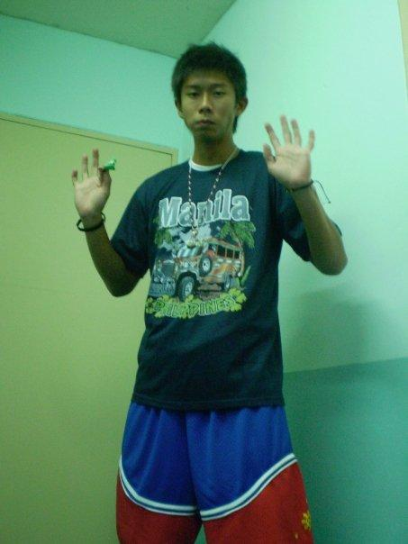
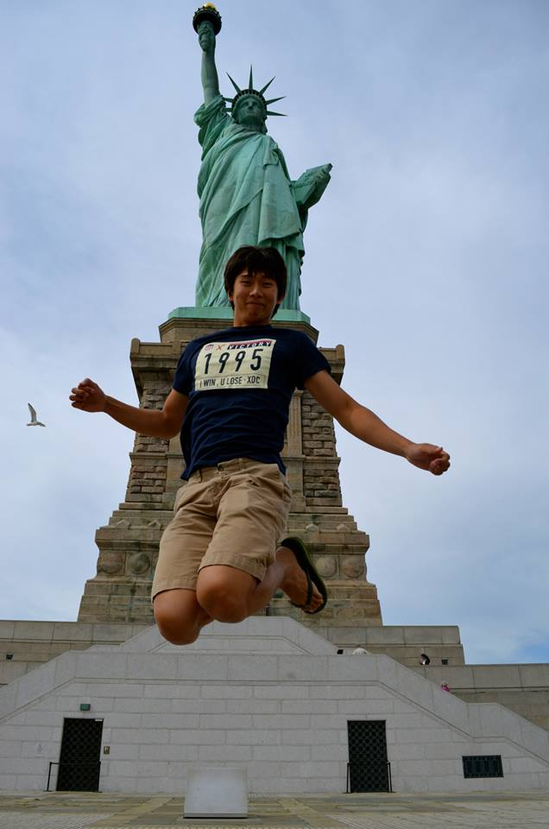
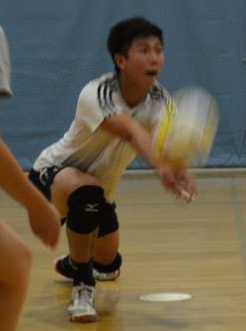
IM Sports Committee!
Jeron Tan

Slide 49
Historian
Tin Tran
historian@apo-x.org

Slide 50
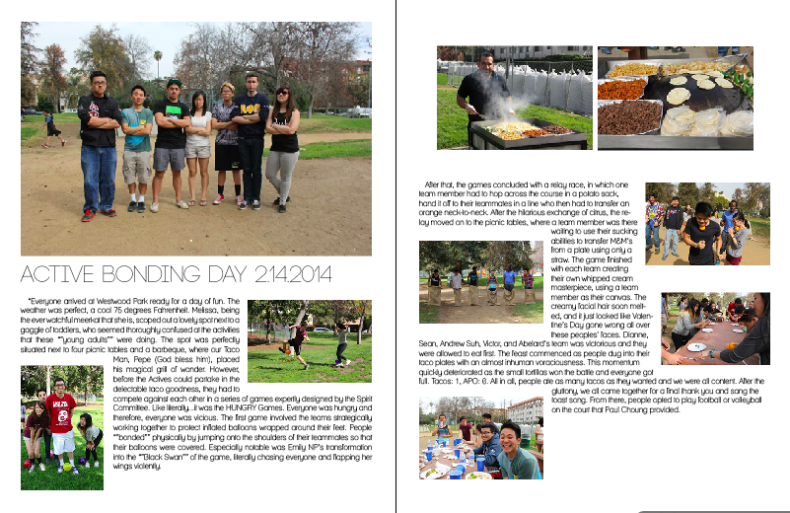

Termbook Updates
Active Bonding Day

Slide 51

Chi Trivia
For actives :
_________________ designed the
Pin and drew the Coat of Arms.

Slide 52
Chi Trivia
For actives :
Everett W. Probst designed the
Pin and drew the Coat of Arms.

Slide 53

Chi Trivia
For pledges :
Leadership, Friendship and Service
are our _______________.
Be a Leader, Be a Friend, Be of Service
is our _____________.

Slide 54
Chi Trivia
For pledges :
Leadership, Friendship and Service
are our Cardinal Principals.
Be a Leader, Be a Friend, Be of Service
is our Fraternity Motto.

Slide 55

Brother of the Week #1
This brother pees 20 times a day

Slide 56
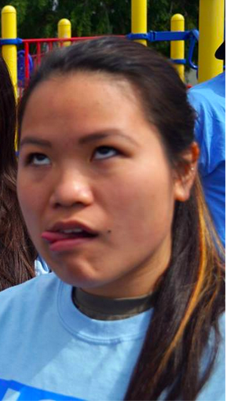
Brother of the Week #1
Sandy Wang

Slide 57

Brother of the Week #2
Hint for the second brother of the week :
Mariah Carey

Slide 58
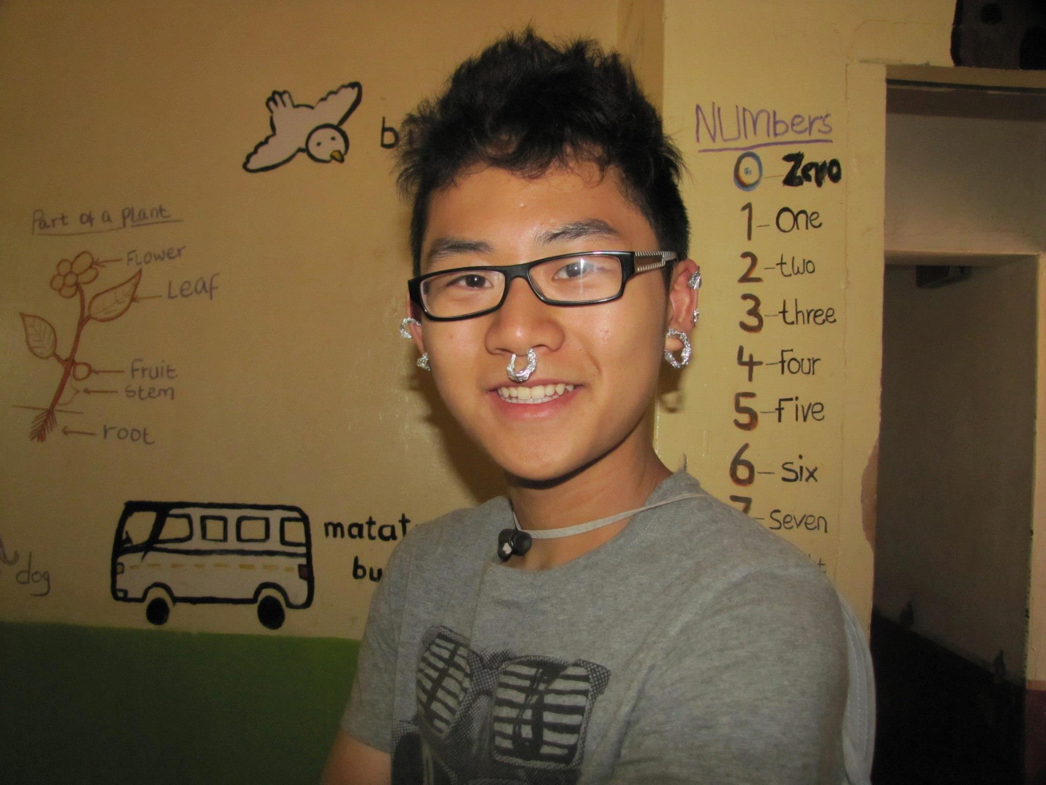
Brother of the Week #2
Nathan Cheung

Slide 59

Termbook Headshots
Good standing actives & associates
with last names starting with A-H
We needs to take a pic of yo beautiful face
Please stay a little bit after toast song

Slide 60
Termbook Headshots
Althea Alquitran
Melissa Barcelona
Abelard Bautista
Rachel Belyea
Talia Berson
Jessica Bobis
Taylor Briglio
Ernesto Bautista
Joseph Chan
Judy Chen
Nathan Cheung
Josh Chin
Harrison Choi
Stephanie Choy
Kendrick Chu
Nancy Chu
Jae Lin Chung
Ann Dai
Anna Do
Vickie Do
Merry Fu
Holly Fuong
Jeremy Gozzip
Rui Guo
Jenny Ham
Angie He
Jessie Hsieh
George Hsin
Peter Huang
Michael Hung
Diane Huynh
Kevin Huynh
Kristine Huynh

Slide 61

Brothers of Chi Chapter
Wanna contribute to the termbook?!
Submit a photo of your fellow brothers with a quote!
Submit to apoxhistorian@gmail.com or facebook… or something

Slide 62
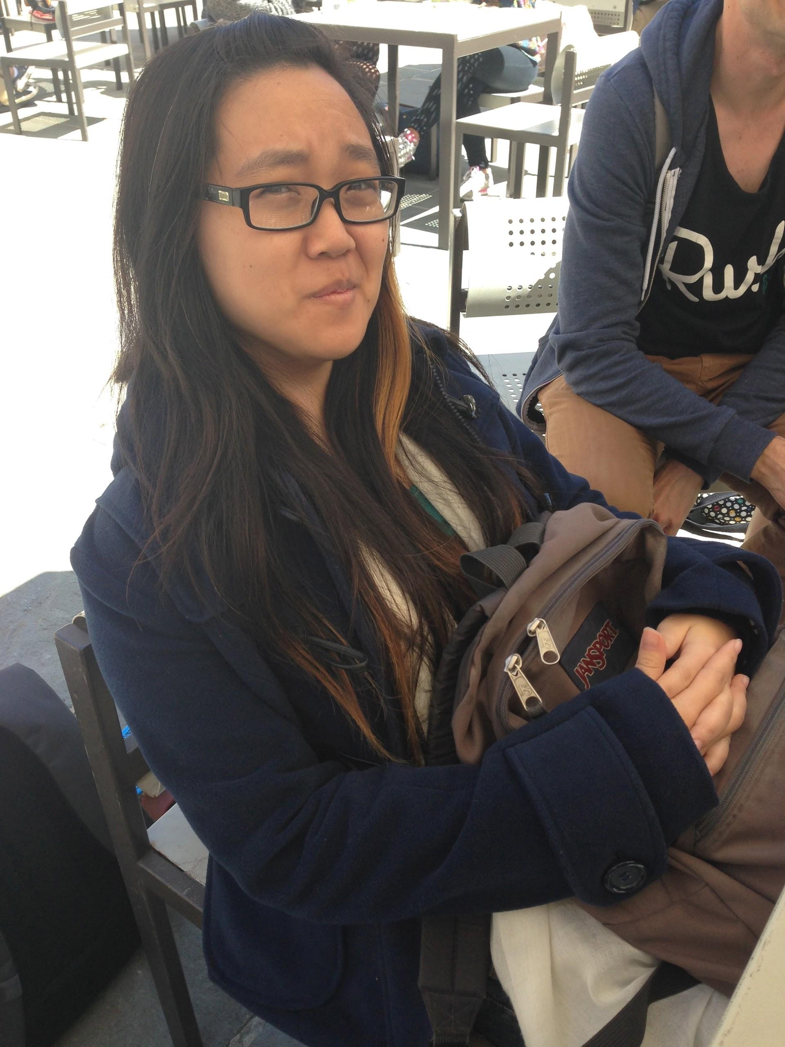
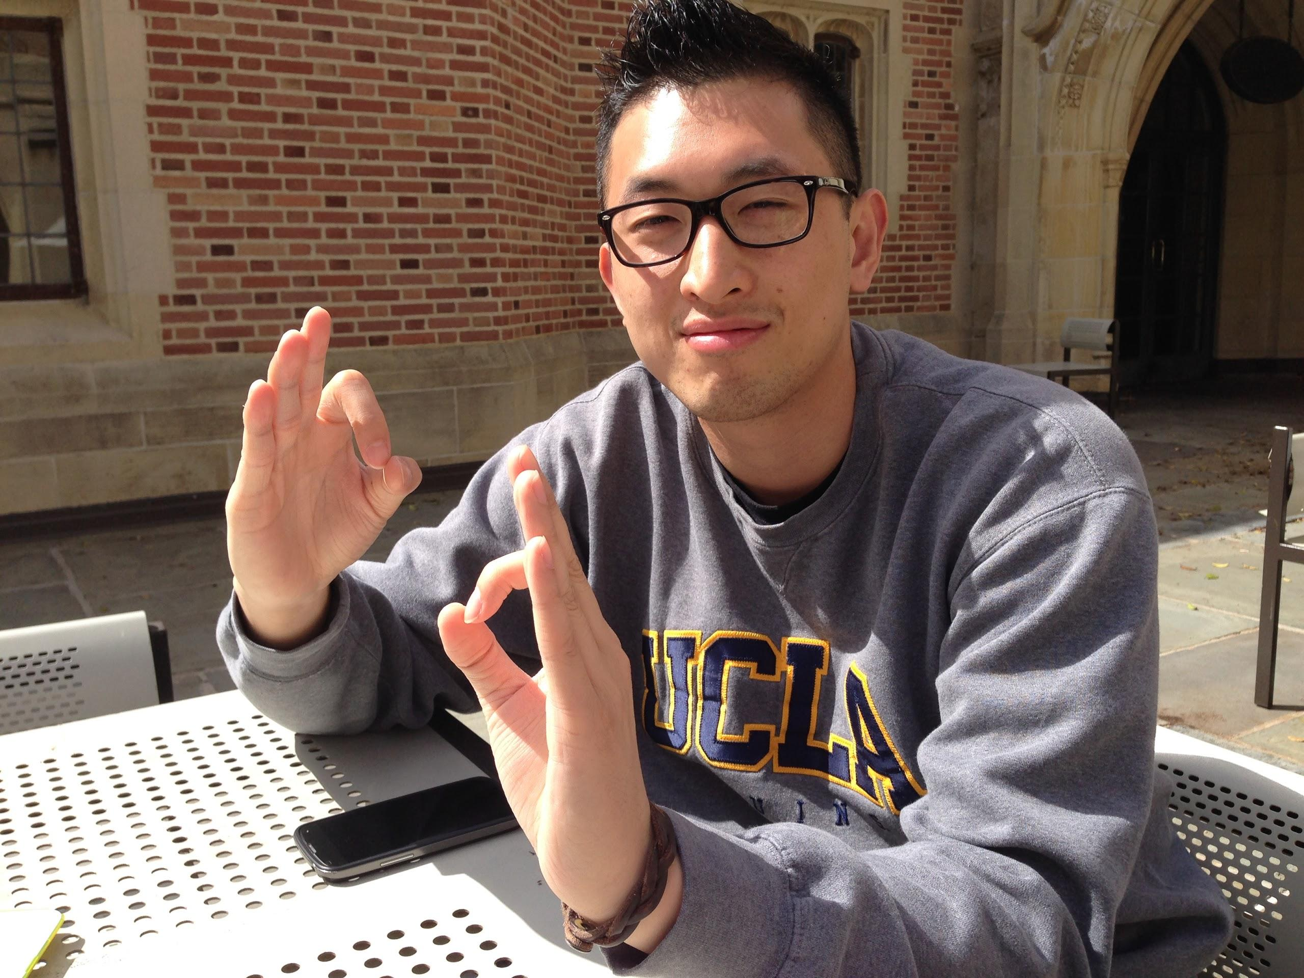
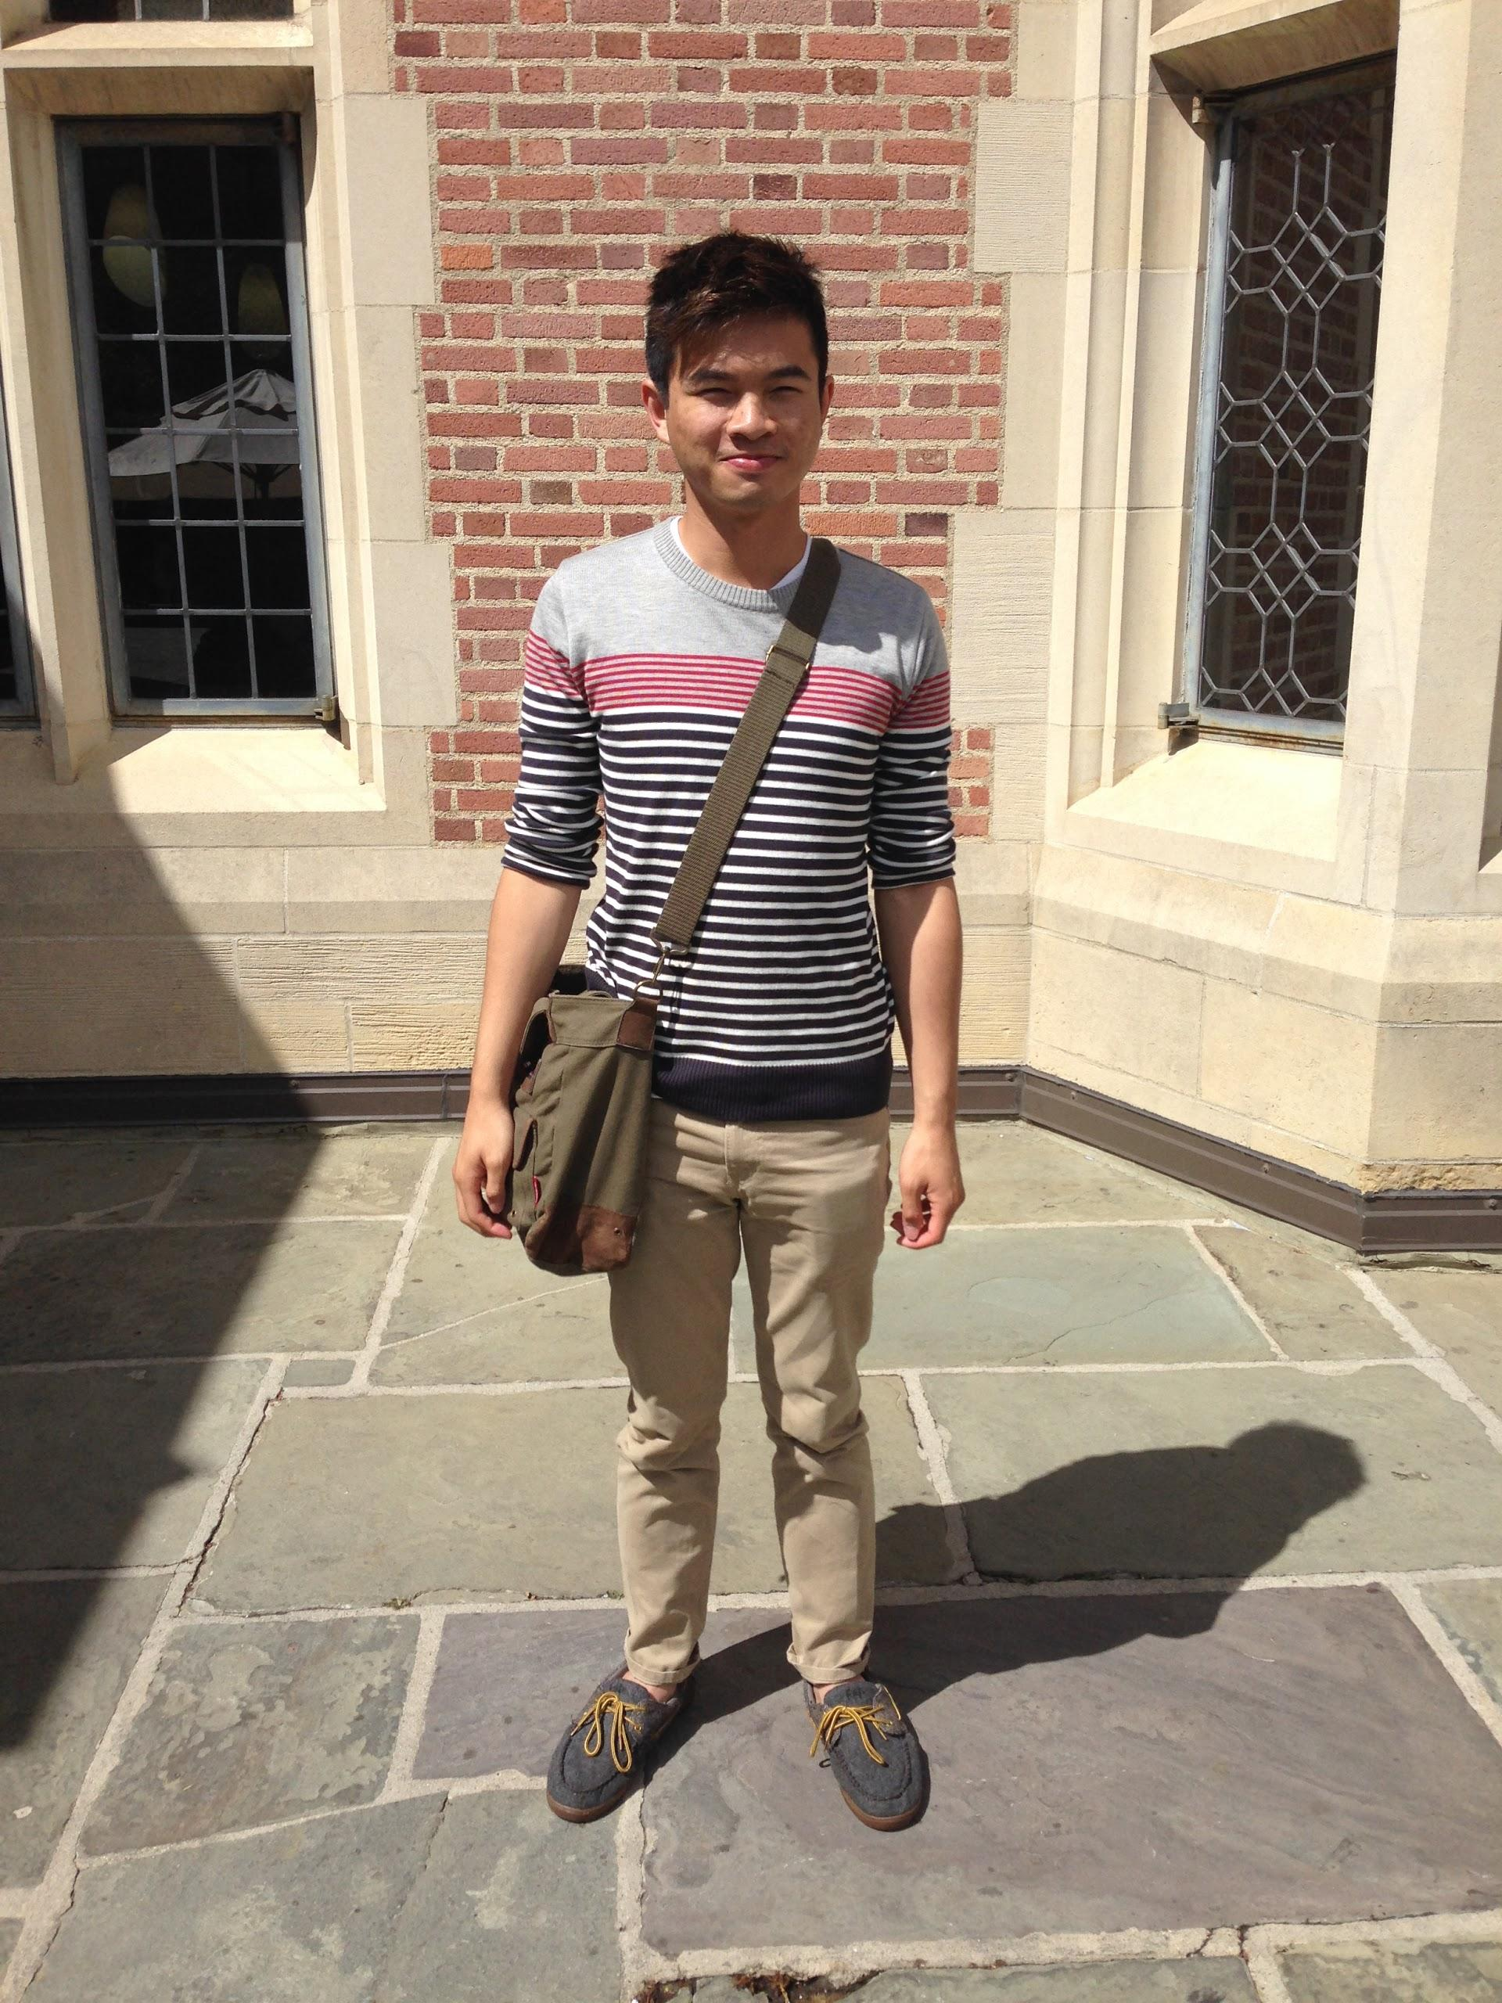
Brothers of Chi Chapter
“I’ve had two dreams where I was pregnant. Maybe it’ll be possible in like 10 years or something.”
“I like guys...with their pants on…”
“Either live by the swag, or die by the swag.”

Slide 63
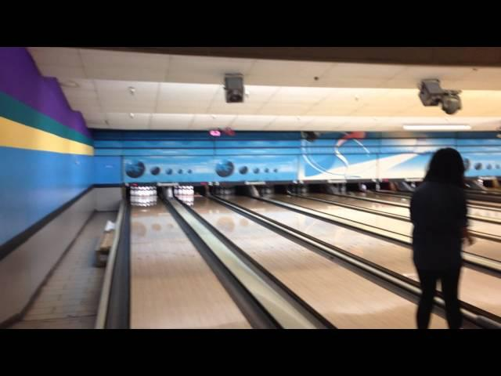
Webisode #2

Slide 64
Sergeant-at-Arms
Catherine Teotico
apoxsergeant@gmail.com

Slide 65

Reminders
In the lost pin form under “Contact Info”, please write your actual phone number or email. Not just meet you in Kerchoff.
Actives please utilize the strike form for any strike. Its hard to keep track when you mention it in passing.
THANKS!!

Slide 66

Chapter Meetings
5 Minutes After President Starts
Late, 1 Strike
Notification Before 6 + Arrive Before 7:30
Credit (No Strike)
No Notification Before 6 + Arrive Before 7:30
Credit (0.5 Strike 1st Time, 1 Strike, Thereafter)
With/ Without Notification + Arrival After 7:30
No Credit, No Strike.
Notification Before 6 + Leave at 8
Credit (Must Notify SAA Before Leaving)
With/ Without Notification + Leave before 8
No Credit, No Strike
Arrive Late + Leave Early + With/Without Notification = No Credit, No Strike
** Please text me instead of facebook. It hard to keep track of people. Through multiple media outlets.

Slide 67

Chapter Meetings
Want Meeting Credit But Can’t Make it to Chapter Meeting? *
Come to Excomm Meeting at 8:00pm, The Sunday Before
Email apoxsergeant@gmail or Text Me 3109618573
At least by 7pm, So we can tell you the location.
*Only valid excuses, not just because you feel like it/more convenient

Slide 68


ABEA
Normally, ABEA goes to the person who provides the best evaluation but this not only did this person provide a great evaluation but an amazingly detailed reminder email.
So by numerous nominations
The ABEA Goes To….

Slide 69
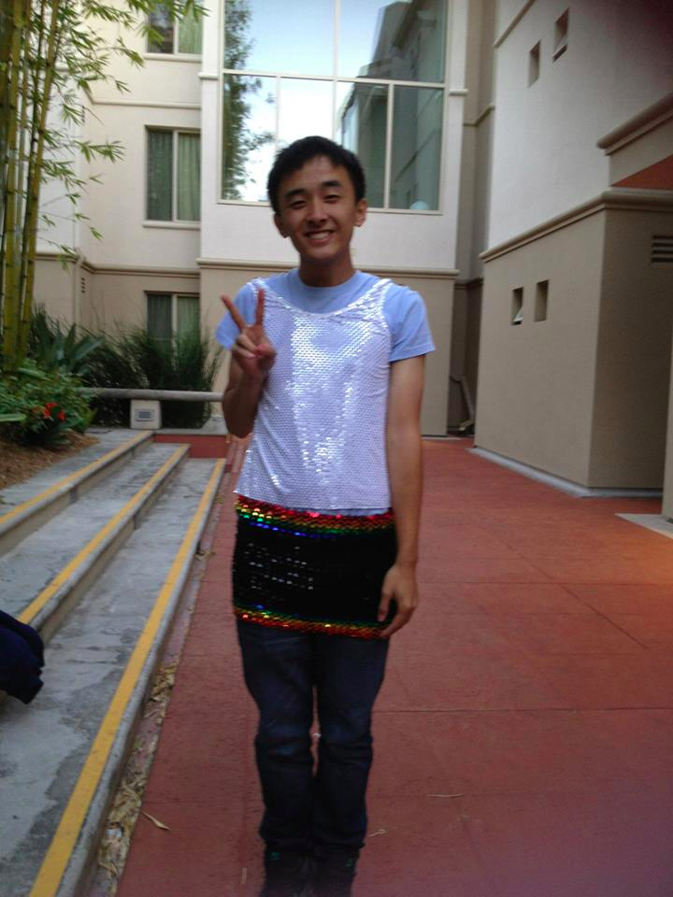
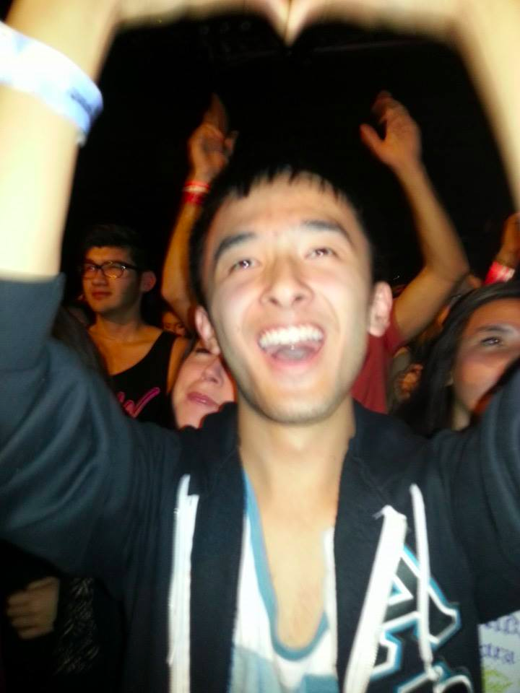
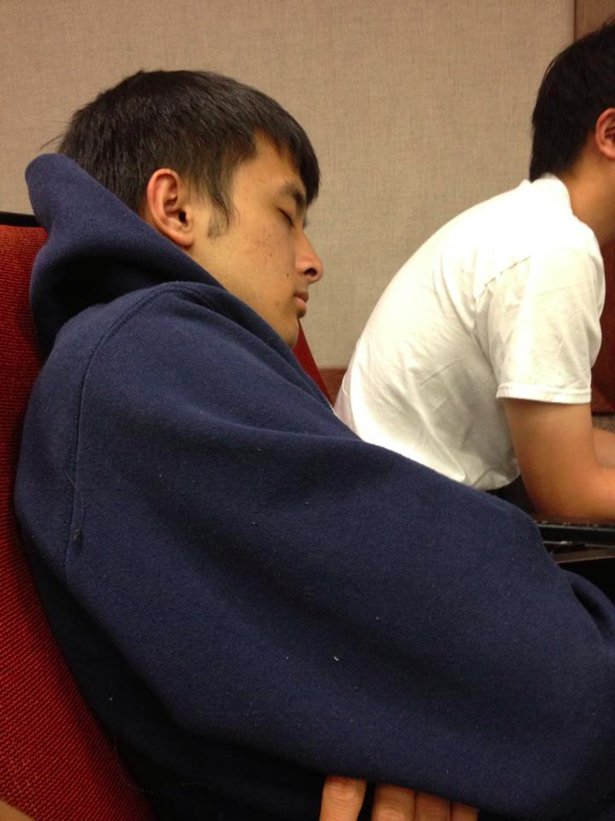
ABEA: JOSEPH CHAN

Slide 70
Interchapter Chair
Olivia Pardo
interchapter@apo-x.org

Slide 71

WELCOME ICS
Name
Pledge term
Favorite video game

Slide 72
Sign up for events!
SLO Bonfire
Registration ends Saturday, April 5
IC Dance Comp
Registration ends April 11
Both have separate forms. Fill those out!

Slide 73
Chair of the
Advisory Committee
Kevin Lee
cac@apo-x.org

Slide 74
Chapter Business

Slide 75
Voting Delegates
Constitution
Alpha Kappa Certificates

Slide 76

Congrats Alpha Kappa!

Slide 77
Voting Delegates
Taylor Briglio
Bowen Lu

Slide 78
Update Constitution
https://docs.google.com/document/d/1Kkg-fzWyKGyXAazwgyp8VsasWh3LZlSrwXUHOeAt7Ac/edit

Slide 79
Last Announcements

